Slide 1
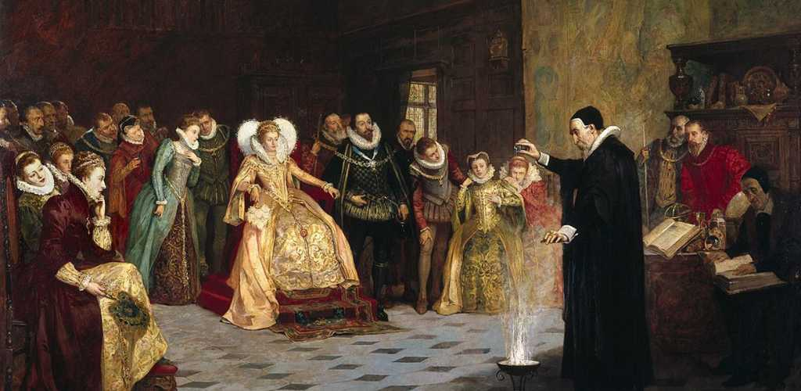
Elizabethan
Poetry
Dr. Khushboo
Assistant Professor
Department of English
Magadh Mahila College

Slide 2
VOCABULARY
Renaissance
Sonnet
Petrarchan
Shakespearean
Spenserian
Iambic foot
Octave
Sestet
Quatrain
Couplet
Conceit
Stock devices
Oxymoron
Simile
Metaphor
Personification
Allusion
Apostrophe
Rhyme scheme
Rhythm
Scansion
Bound verse
Polyrhythmic/free verse

Slide 3
ELIZABETHAN ERA
FROM - 1558-1603
Also known as:
Golden age
English renaissance
Age of shakespeare
Beginning of British empire
Preceded by- Tudor period
Followed by- Jacobian era

Slide 4
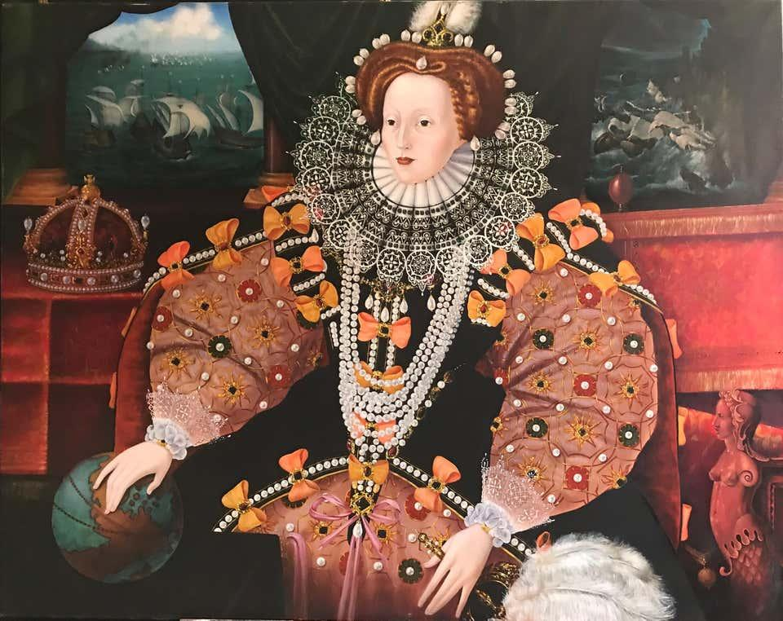
QUEEN ELIZABETH 1
Born-7 September 1533,Palace of Placentia, Greenwich, England
Died-24 March 1603 (aged 69),Richmond Palace, Surrey, England
Predecessors-Mary I and Philip
Successor-James I
Coronation-15 January 1559

Slide 5
Troubled times turn into good times…
Elizabeth I (Good Queen Bess) took the throne.
Got England out of debt
Stopped wars with Spain
Sponsored the arts
Worked out a compromise on religion

Slide 6
FEATURES OF ELIZABETHAN AGE
Humanism
The Reformation
Feeling of Nationalism and Patriotism
An Age of Material Advancement
New Discoveries
Printing and Education
Revival of interest in Greek and Latin Literature
“Man started to think for themselves and started questioning accepted beliefs.”

Slide 7
The Renaissance’s Influence on Learning:
Learning was important & for everyone
Before Caxton printed his first book(1476) in English, no more than 2% of the English people could read.
Afterwards, learning increased rapidly-from the Crown to the commoner.
Access of information is easier
Books become more accessible
The Renaissance influenced a critical study of the Scriptures which partly led to a challenge of Roman Catholicism & the emergence of English Protestantism.

Slide 8
Poetry in Elizabethan age
The development of Poetry is the strongest characteristic of the age .
During Elizabeth I’s reign, “England was called a nest of singing birds;
every courtier felt it part of his duty to write poetry;
sonnet sequences by the hundreds appeared;
and English poetry was the admiration of all Europe.”

Slide 9
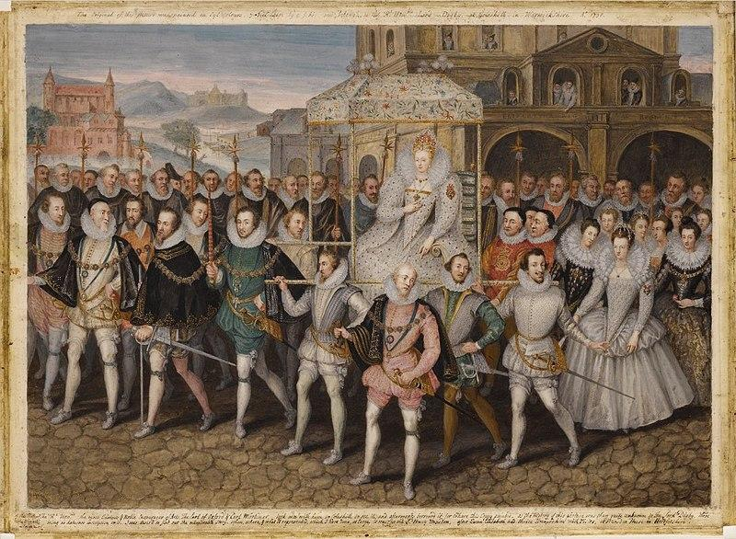

Slide 10
POETIC GENRES
Pastoral: songs, dialogues, funeral elegies, romances (John Milton, ‘Lycidas’)
Satires
Lyric poems: hymns, odes, epithalamiums
Songs: popular ballads, madrigals, airs
Sonnets (Shakespeare, The Sonnets)
Mythological-erotic poems (Marlowe, ‘Hero and Leander’)
Epic poems (Spenser, The Faerie Queene)

Slide 11
Elizabethan Poetry Literary Devices
Conceits- were prominent in many love poems.
unusual and elaborate comparisons between two dissimilar things.
these images were usually about a despairing lover and his unpitying, but idolized, mistress.
Ex. A lover is compared to a ship on a stormy sea and his mistress is a cloud of dark disdain.
Stock devices – themes, characters, etc. which show up again and again
Stock devices – themes, characters, etc. which show up again and again. This is especially apparent in poems dealing with the tradition of courtly love.
-The idea of the cruel or indifferent mistress
-The idea of the all-consuming passion
-The pale, wan lover

Slide 12
The paradoxical pain and pleasure of lovesickness is often described using oxymorons- (a figure of speech that combines normally-contradictory terms. Ex. wise fool, failed success, dark sunshine
Similes
Metaphors
Personification
Allusion -making reference to a famous historical event, literary figure, or pop culture person/event that would be known of by the majority of the population.
Apostrophe -to address the absent as though present, the dead as though living, or the inanimate object as if it were animate. Ex: an invocation to the muses.

Slide 13
Rhyme scheme
Rhythm –accented and unaccented syllables.
Iambic- an unstressed syllable followed by a stressed syllable. Ta THUMP
To swell the gourd, and plump the hazel shells.
(iambic feet) (pentameter, etc.)
Scansion-the division of verse into feet by indicating accents and syllables to determine the meter of a poem.
(A line of iambic pentameter is five iambic feet in a row:
da DUM da DUM da DUM da DUM da DUM
To swell / the gourd, / and plump / the haz / el shells.

Slide 14
RHYTHM TYPES
Iambic ~ / (The most common meter in our language and naturally falls into everyday conversation. To BE or NOT to BE-Shakespeare.
Trochaic / ~ DOUBle DOUBle TOIL and TROUBle.
Anapestic ~ ~ / I aRISE and unBUILD it aGAIN.
Dactylic / ~ ~ Openly
Spondee / / HEARTBREAK
Pyrrhic ~ ~ (generally used to vary rhythm)

Slide 15
Poetry notes
Form
Rhythm & rhyme
Imagery
Diction
Theme
Mood

Slide 16
Bound Verse is poetry which must conform to a specific pattern:
Uniform line length
Consistency in the number of lines in a stanza
Rhythm must be uniform (but may have exceptions)
Rhyme scheme should have a pattern
Free Verse/Polyrhythmic Verse
Does not have to conform to a specific structure
Is distinguished by an irregular metrical pattern
The focus is not on the way it is written, but on the message

Slide 17
SONNET
There are three types of sonnets-
Petrarchan or italian sonnet
Shakespearean sonnet
Spenserian sonnet

Slide 18
The Italian sonnet
Also called ‘Petrarchan’ sonnet.
Octave (2 quatrains): abba abba; it expresses the first half of an idea or poses a question.
Sestet (2 terzets): cde cde / cdc dcd ; etc.; it develops the idea expressed in the octave, or gives the answer to the question.
Volta: a pause between the octave and the sestet.

Slide 19
THE ENGLISH SONNET
Also called ‘Shakespearean’ sonnet
3 quatrains: abab cdcd efef; it contains the development of an idea
Couplet: gg; an epigrammatic conclusion

Slide 20
THE SPENSERIAN SONNET
Invented by Edmund Spenser
Also called ‘Linked’ sonnet
3 quatrains + 1 couplet
Rhyme scheme: abab bcbc cdcd ee

Slide 21
What were sonnets written about ?
Love
Nationalistic pride
Man’s potential
Nature
Seven deadly sins-Gluttony, lust, pride, envy, wrath, sloth, and avarice
Seven cardinal virtues-Faith, hope, love, prudence, justice, fortitude and temperance

Slide 22
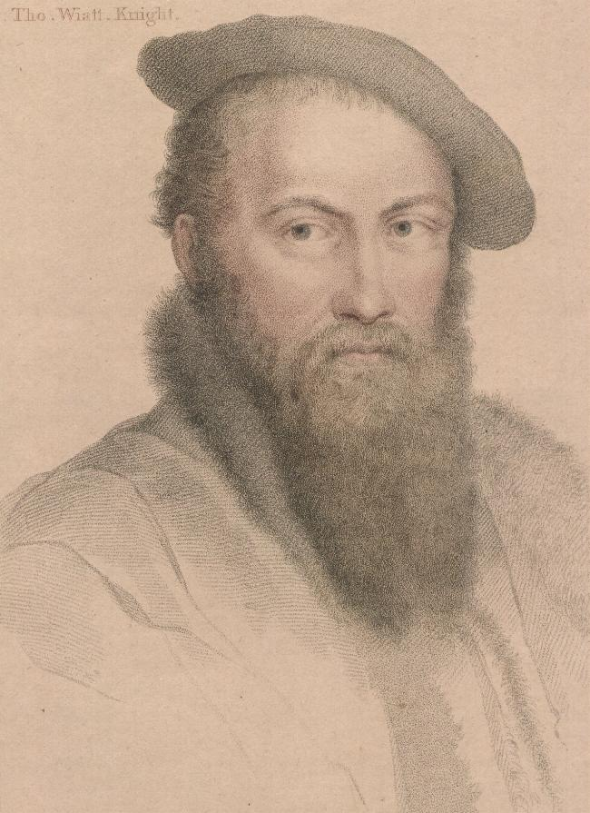
Holbein’s drawing of Sir Thomas Wyatt (c.1532-42)

Slide 23
ABOUT
Born in Allington, educated in Cambridge.
He was knighted in 1537. Served two years an ambassador to Charles V.
Was called “drunk deep of Italian poetry”. Was filled with the spirit of the new culture. Brought from Italy Love poetry( which was called ‘Amourist’ poetry at that time) and The Sonnet (the petrarchan form) which was closely related to love poetry.
His works are Remembrance, Epigram written in Prison.

Slide 24
Contribution
Brought sonnets to english literature.
Was influenced by Italian verse forms.
But ; not yet iambic pentameters.
works-They Flee From Me,Whoso List To Hunt,Lux,Blame Not My Lute etc.

Slide 25
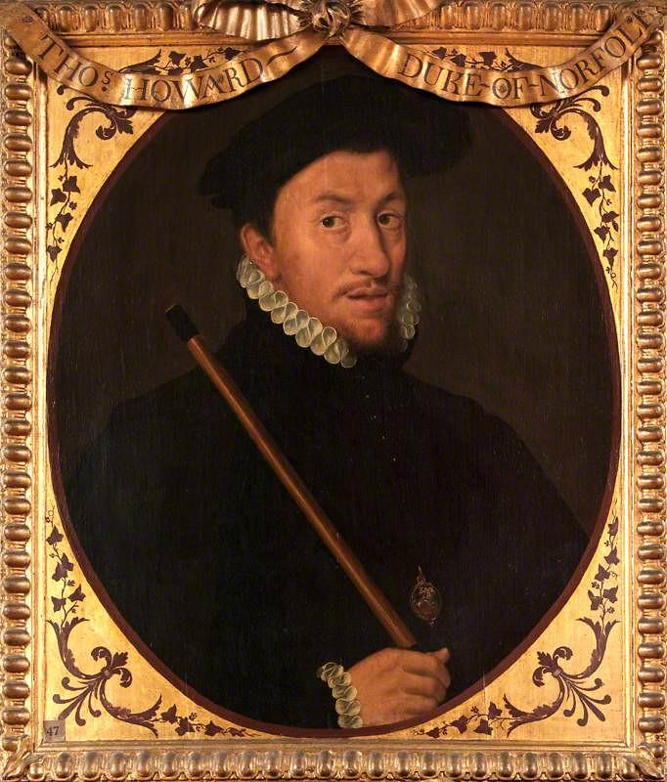
EARL OF SURREY
HENRY HOWARD
Born: 1517, Hunsdon, United Kingdom
Died: 19 January 1547, Tower Hill, London, United Kingdom
Noble family: Howard

Slide 26
Surrey’s innovation
Earl of Surrey Was one of Wyatt’s disciples.
First use of blank verse in his translation of the Aeneid
15 sonnets, 10 of which are English sonnets
Structure: alternating rhymes, quatrains + couplet (but not epigrammatic conclusion)
Blank verse-a type of poetry, distinguished by having a regular meter, but no rhyme. In English, the meter most commonly used with blank verse has been iambic pentameter (as used in Shakespearean plays).

Slide 27
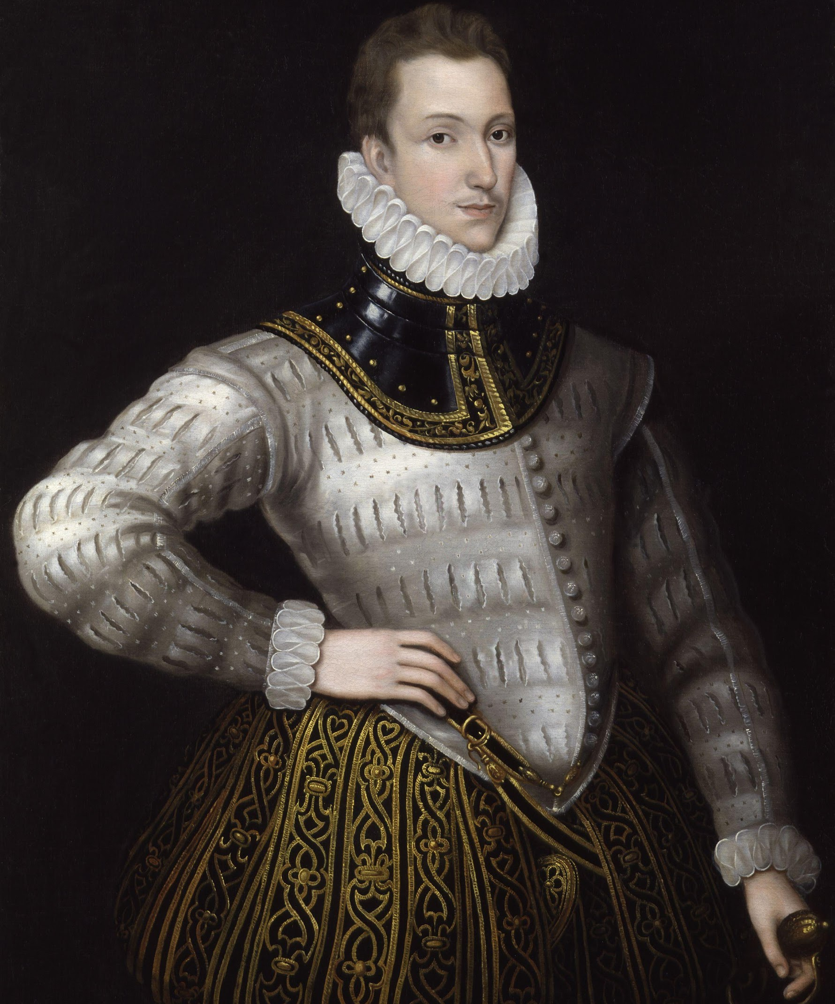
PHILIP SIDNEY
Born: 30 November 1554, Penshurst, United Kingdom
Died: 17 October 1586, Arnhem, Netherlands
Spouse: Frances Walsingham, Countess of Essex (m. 1583–1586)
Education: University of Oxford, Shrewsbury School, Christ Church

Slide 28
about
He was a courtier, soldier, poet and was educated at Oxford.
He is considered an ideal Englishman.
He defended of poetry against the puritans in An Apologie for Poetrie.
He was the friend of Spenser and is represented by him as Sir Calidore in his legend of courtesy in the Fairie Queene.
wrote the first true sonnet sequence in English, entitled Astrophil and Stella.
Important three works are Arcadia, An Apologie for Poetrie( 1595), commonly known as Defence of Poesie and Astrophel and Stella.

Slide 29
Poetic theory of Sidney
A Defence of Poesie (1582)
Poetry should teach and delight; art imitates nature
But: imitation of an ideal nature
The poet as ‘vates’ and ‘maker’a

Slide 30
SIDNEY’S INNOVATIONS
The first full sonnet sequence: Astrophel and Stella (1581), 108 sonnets and 11 songs; is based on an autobiographical situation (Penelope Devereux)
6 sonnets in alexandrines (12-syllable lines adapted from the French)
Epigrammatic conclusion in the last line

Slide 31
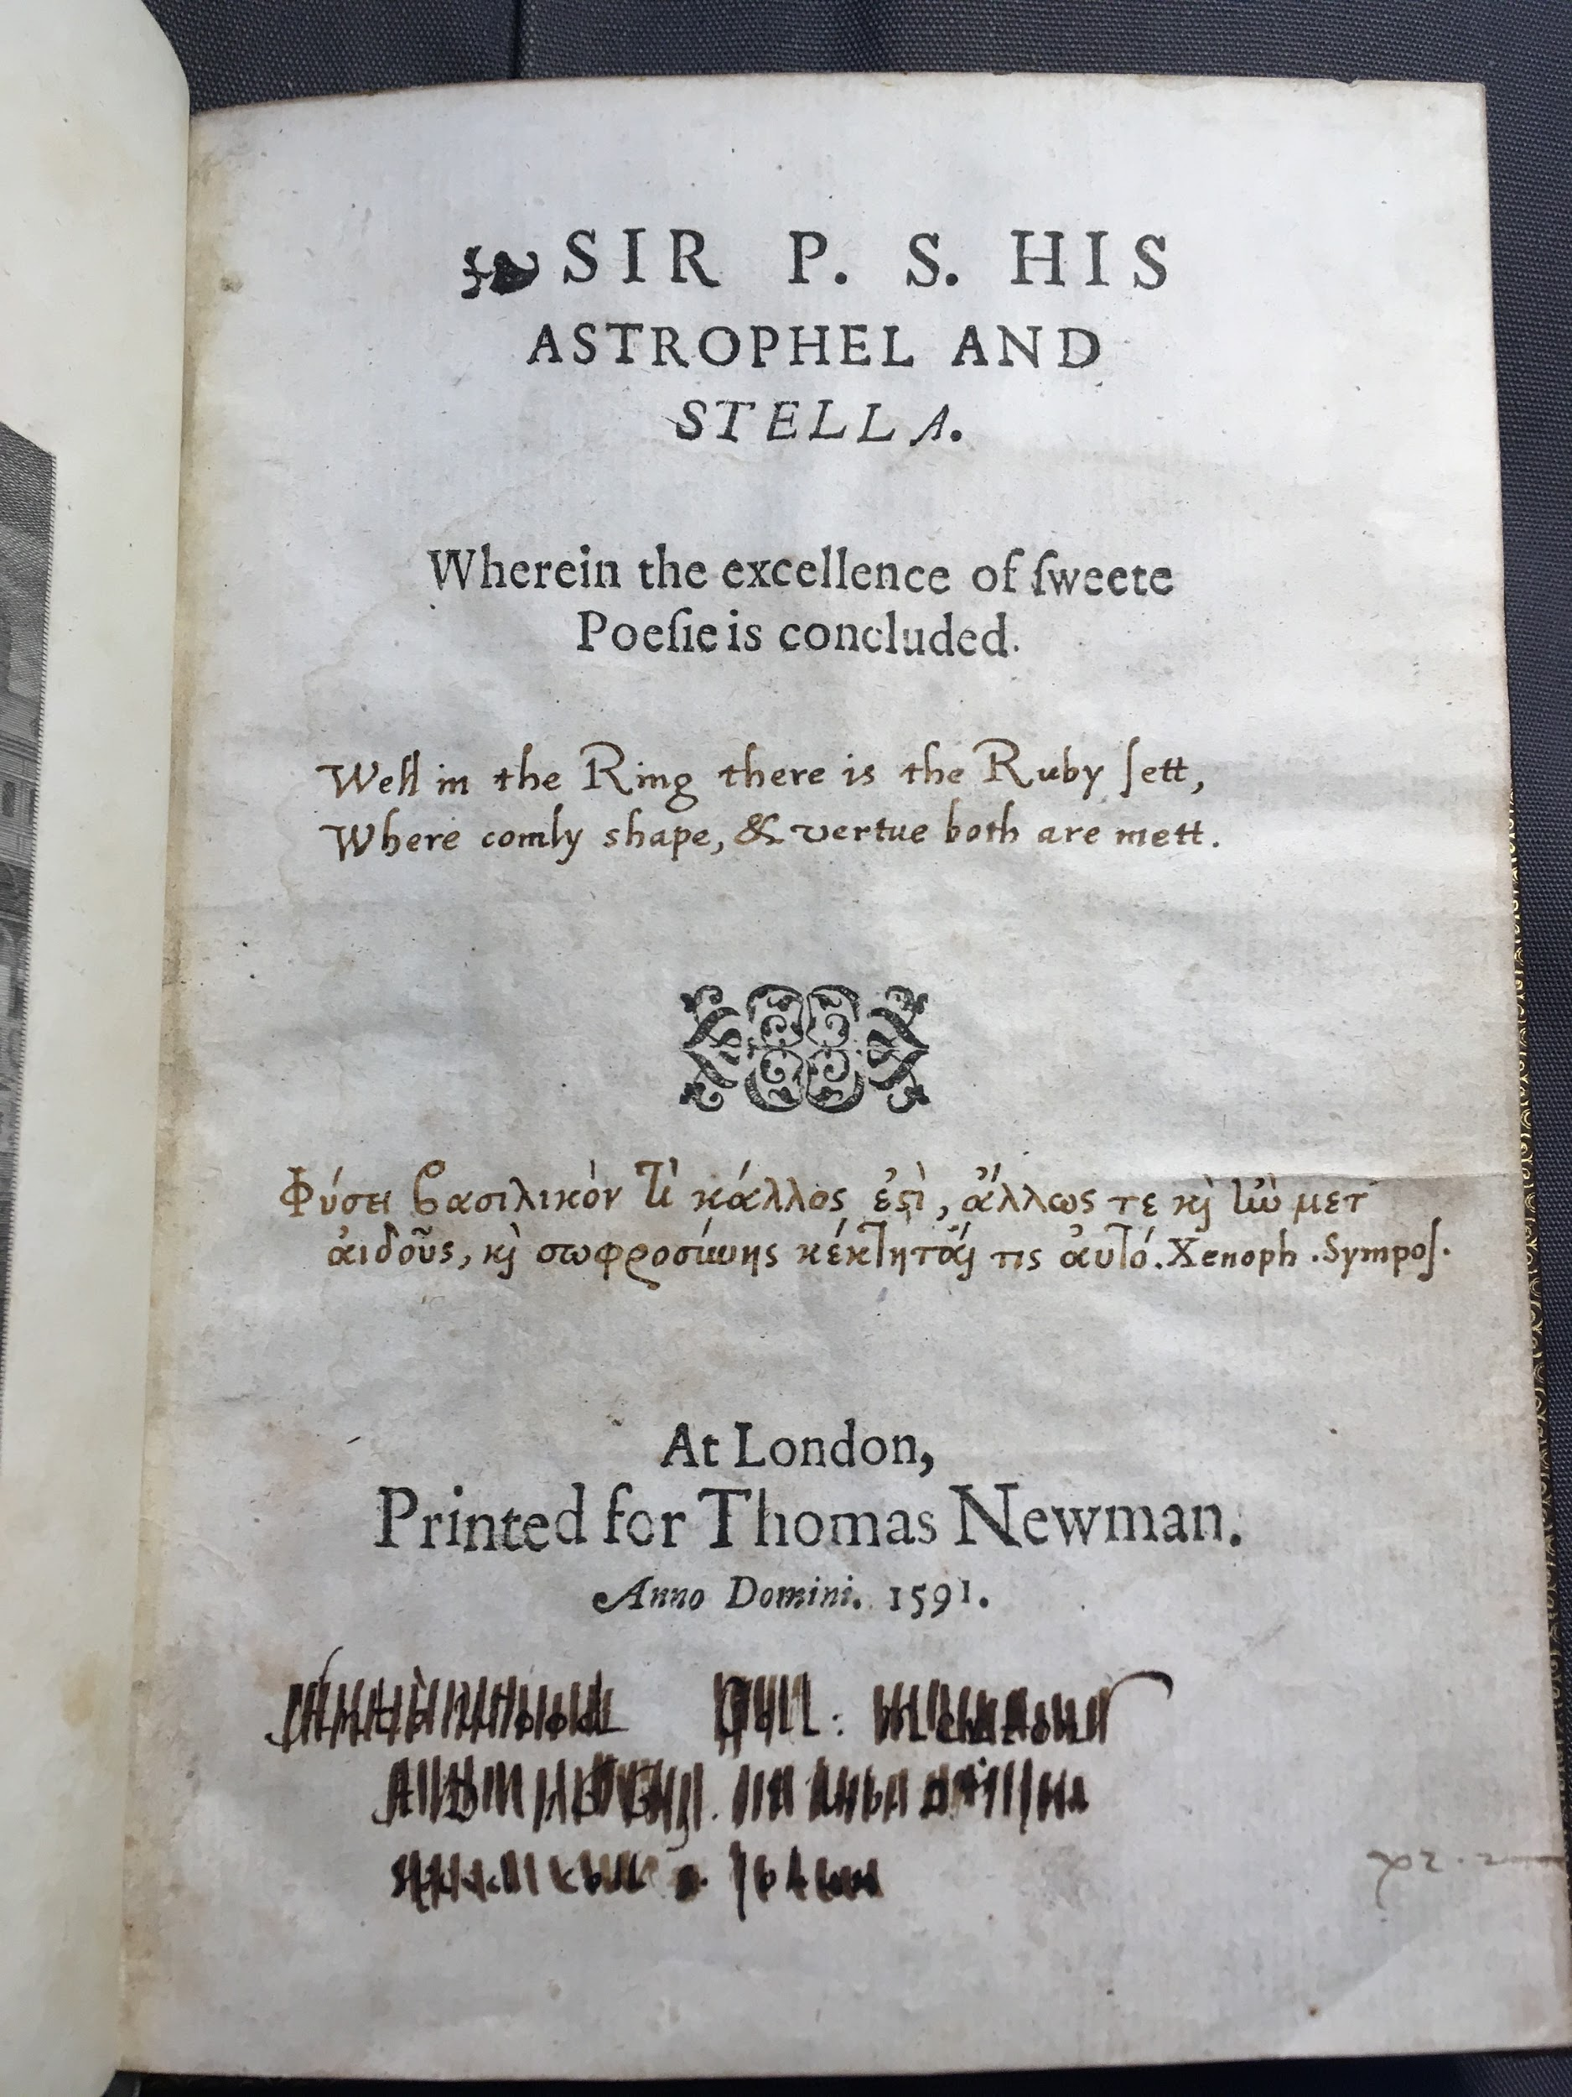
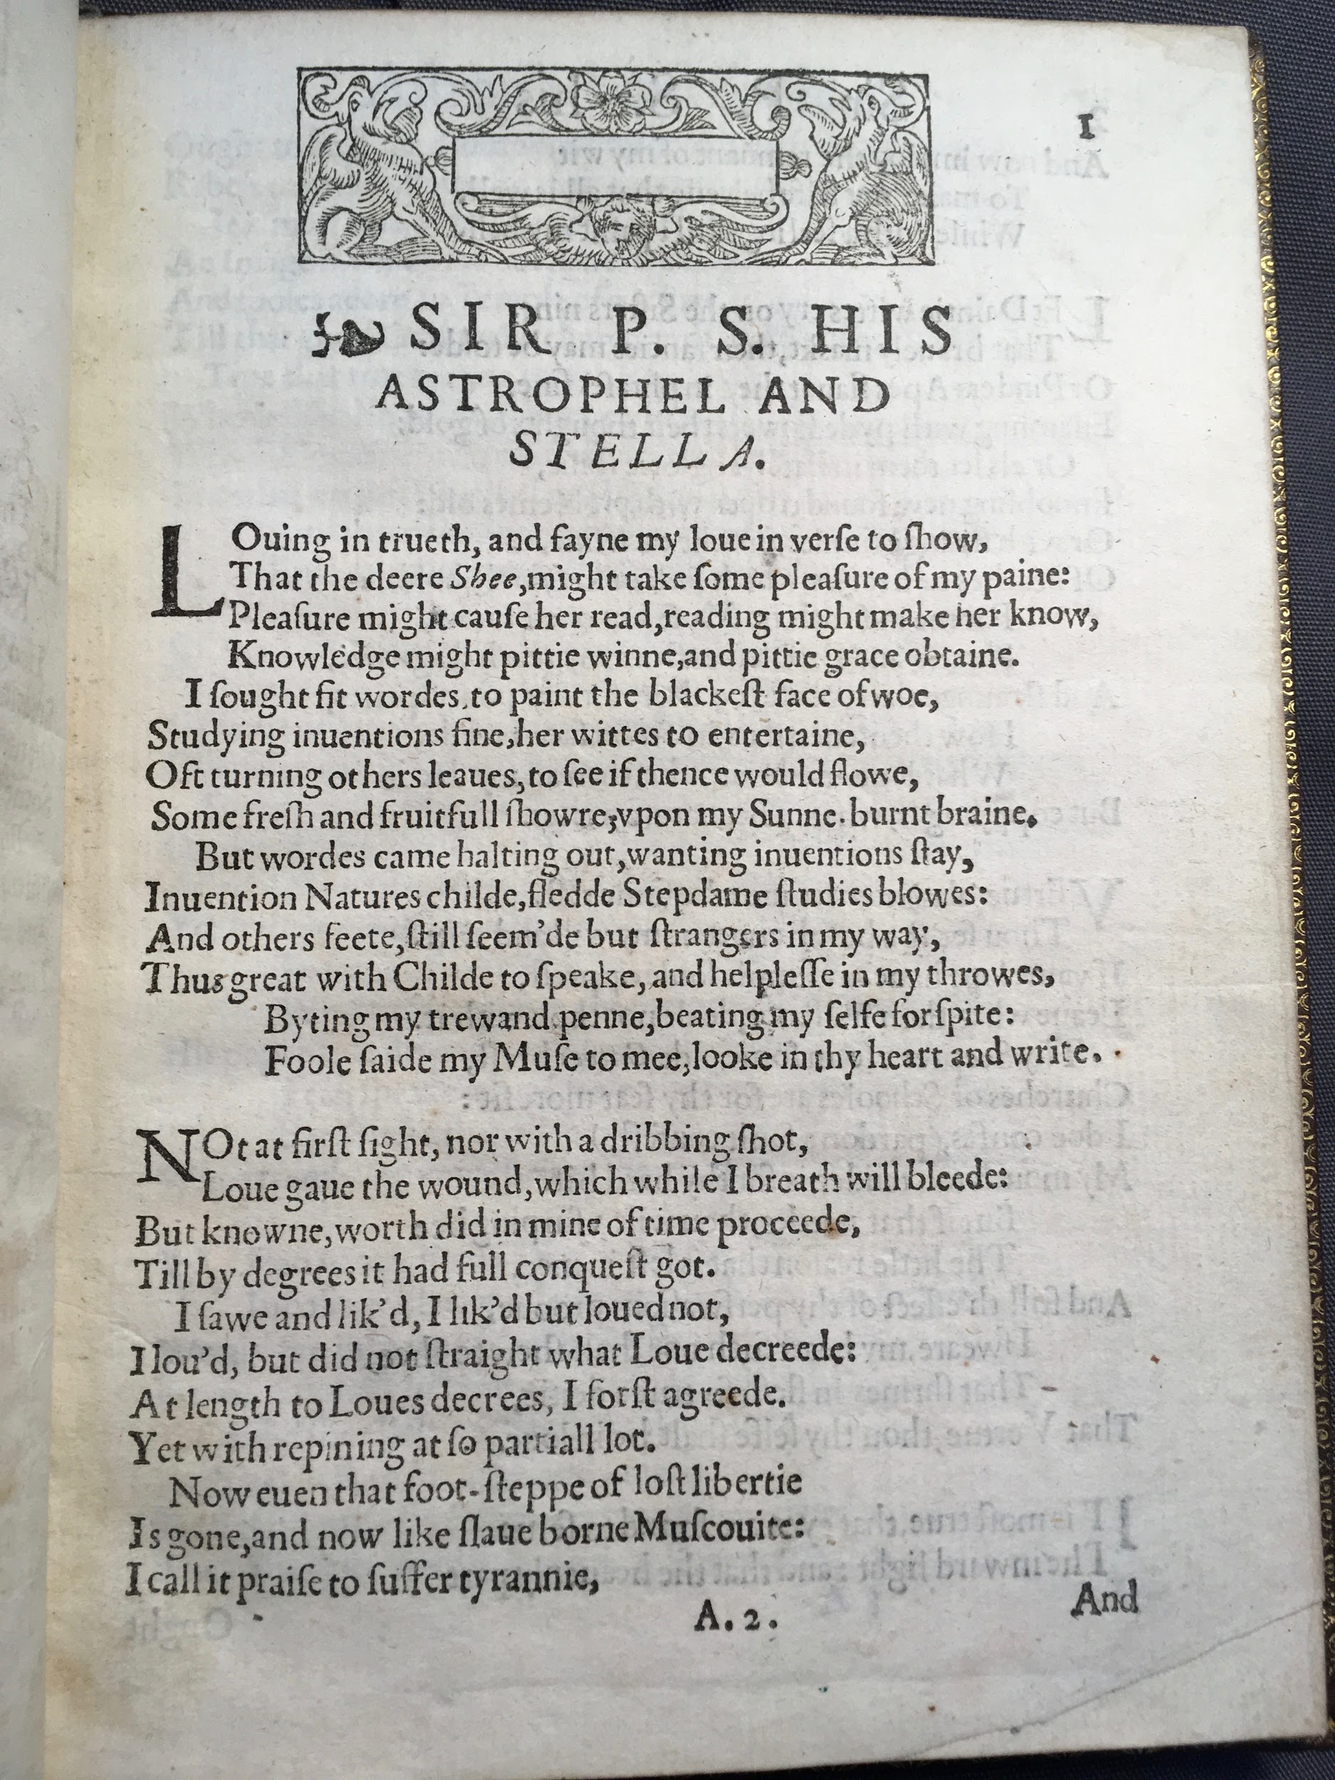

Slide 32
Astrophil and Stella
The title means “Star-lover and Star”, and the poems seem to be extremely biographical – he is Astrophil, and Stella is Penelope Devereux. Once again, the focus of the poems is his bitter, unrequited love.
Sidney follows many of the sonnet conventions, but also dramatizes Astrophil’s state of mind through the use of a great deal of dialogue, colloquial speech, and self-analysis.
In this case, the conceit is that he is a slave to “love”.

Slide 33
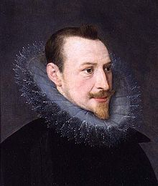
Born-1552/1553,London, England
Died-13 January 1599 (aged 46–47)London, England
Attended Cambridge University
Influenced by Gabriel Harvey (prominent professor at the University)
Married Elizabeth Boyle in 1595
Secretary for bishop of kent/queen Elizabeth's court
Greatest work-The Fairie Queene , died working on it.
Edward spenser

Slide 34
SPENSER’S POETICS
Renaissance Neoplatonism
Puritanism
Patriotism
Conscious preparation for the task of an epic poem: The Shepherd’s Calendar, Amoretti, ‘Prothalamion’, ‘Epithalamion’, The Faerie Queene

Slide 35
SPENSER’S STYLE
Supreme in his vision
Ultimate world of poetic fluency
Ornate imagination
Rich imagery
Lofty idealism
Sensuous poet
Luxuriant colour
Verbal music
Experimented with language; enriched it
Used archaism, allusions

Slide 36
SPENSER’S INNOVATIONS
Amoretti (early 1590s): a sonnet sequence (89); puritan / humanist adaptation of the Petrarchan sonnet sequence
Spenserian sonnets: linked quatrains
Epigrammatic couplet
‘Yoking together the spiritual and the fleshy’

Slide 37
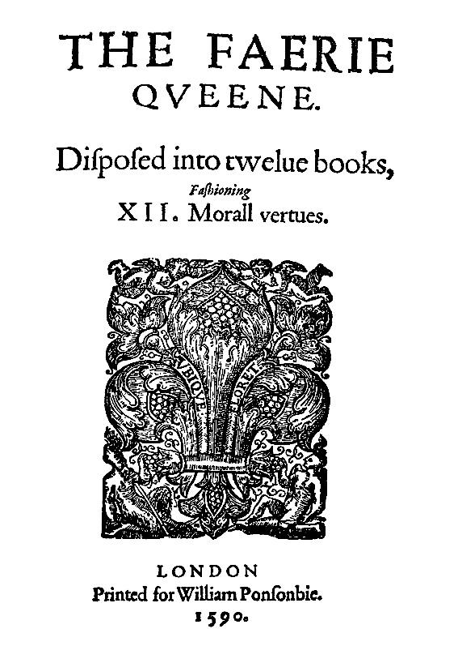
The subjects of Faerie Land are called Faeries or elves, but they are human beings who undergo the trials and tribulations that people undergo in ordinary life.
The Land is also inhabited by knights and ladies who are Britons-Redcrosse Knight, Prince Arthur, etc.
The bad creatures, people, and monsters represent various vices, evils,and temptations. In this way, the poem is an allegory.

Slide 38
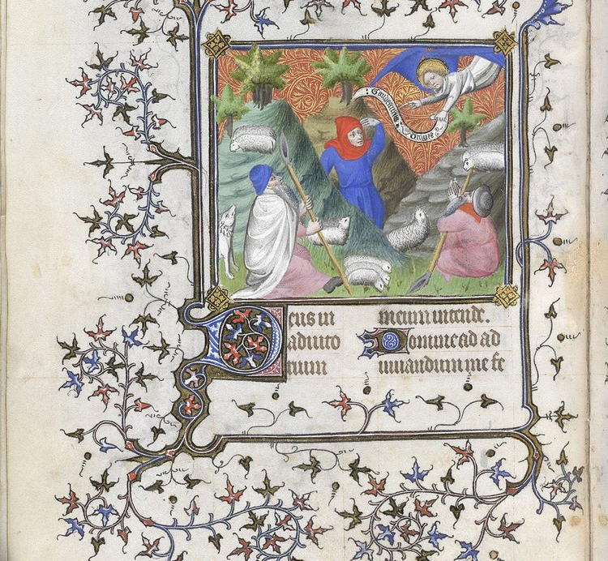
THE SHEPHERD’S CALENDER
The Shepheardes Calendar was a poetic work that consisted of 12 books. Each was prefaced with a woodcut art that represented the story and the appropriate sign of the zodiac.
The Shepherds in each story are believed to depict people from Spenser’s life including himself.

Slide 39
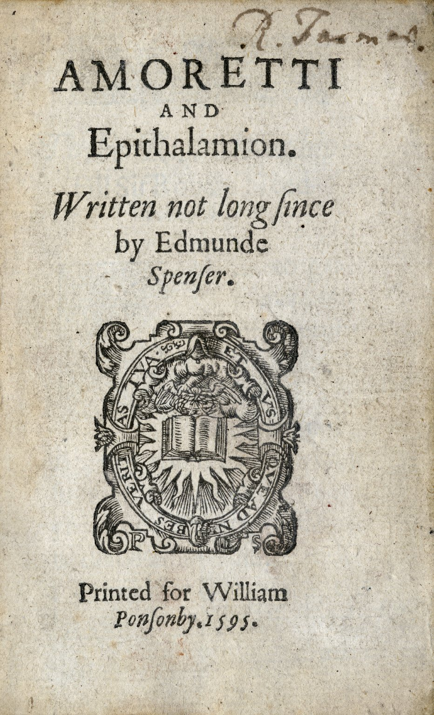
IN 1580 When spenser was sent to Ireland to hold english property on oft-rebellious island ,he met Elizabeth Boyle.
Suit to win her hand in marriage is recorded in Amoretti.
The marriage itself was celebrated in Epithalamion.

Slide 40
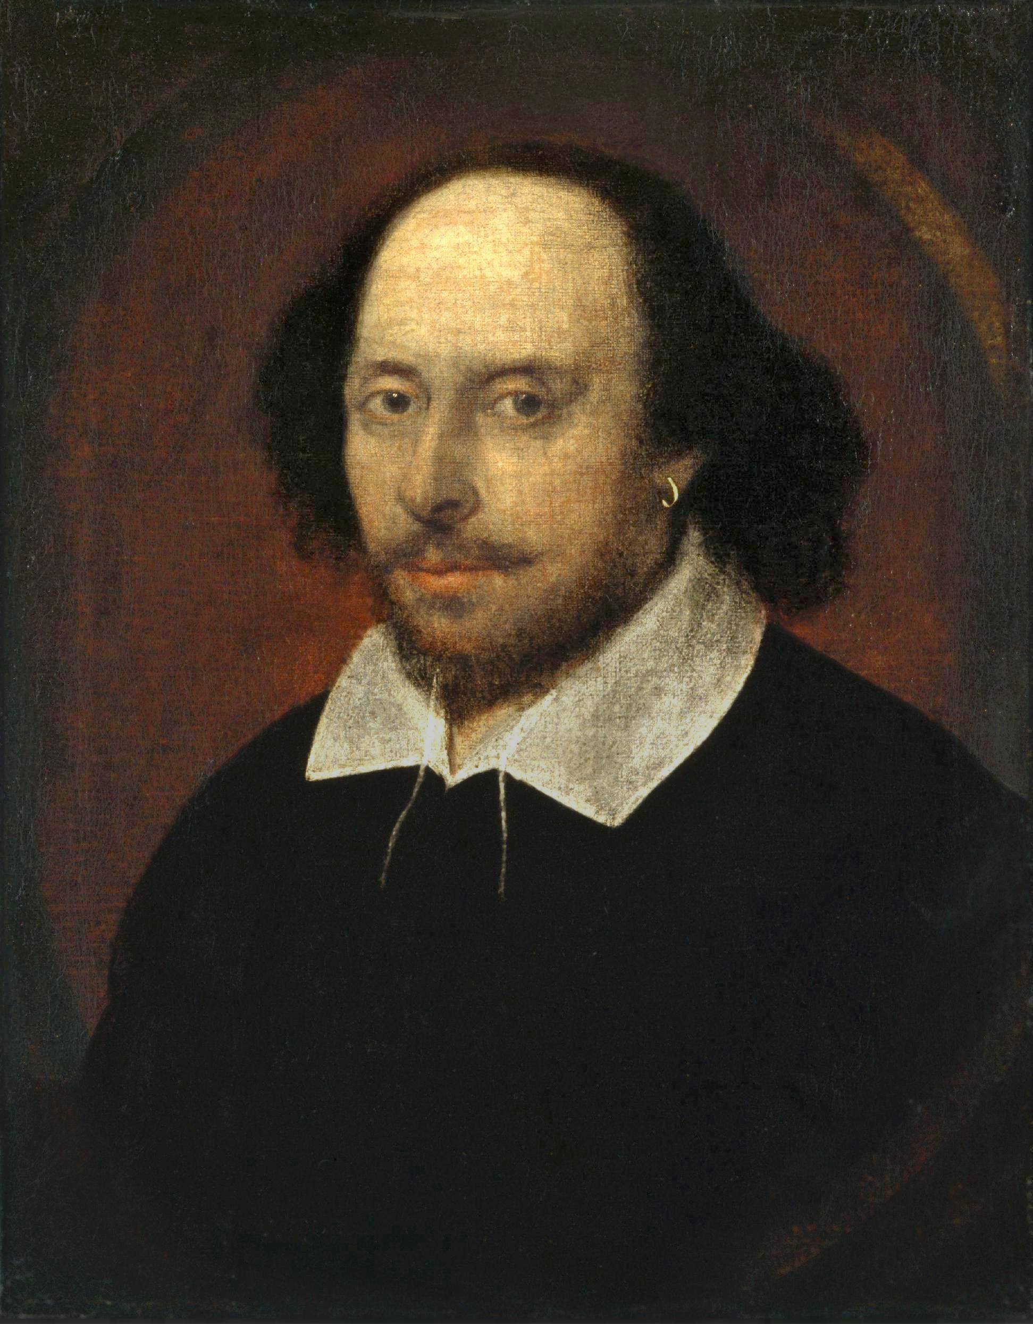
William Shakespeare
(Bard Of Avon)

Slide 41
ABOUT
Shakespeare was born on April 23,1564, and died on April 23,1616.
At 18, he married Anne Hathaway. •
He was one of the few fortunate boys to attend grammar school.
He began working as an actor and a playwright when he was in his teens.
Shakespeare wrote several famous plays and book-length poems.
Historians have been led to believe that the majority of Shakespeare’s writing was not published, and is somewhere, lost forever. •

Slide 42
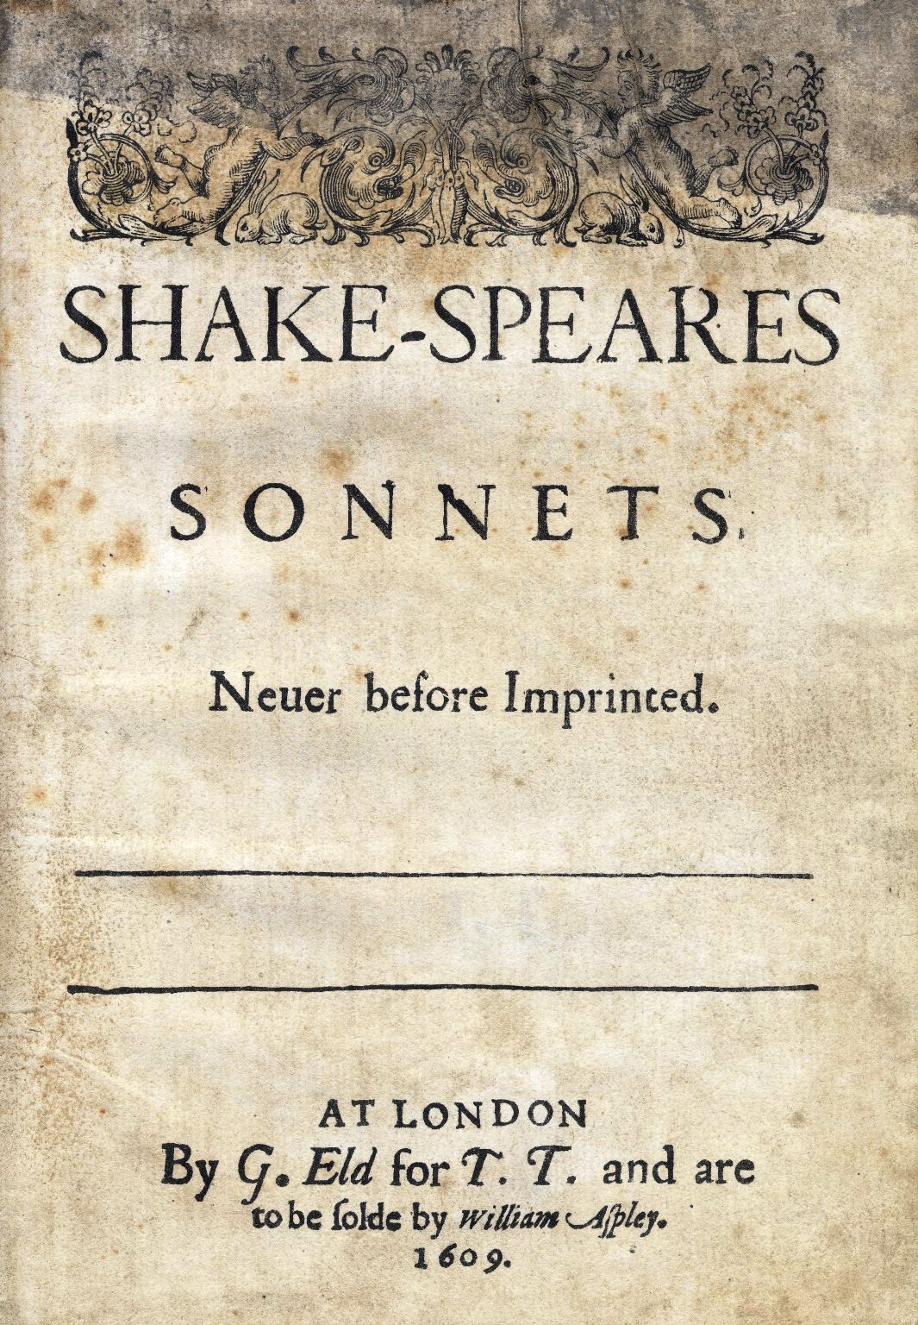
154 in total .
Published in 1609 .
Collection rather than a sequence .
Aware of Petrarchan conventions sometimes uses them, just as often upends them .
The cruel loved one in many of his sonnets is a man rather than a woman .
The “Dark Lady” in sonnets 127-152 is neither virtuous nor ideally beautiful.
Organization
The three quatrains express related ideas and examples or present a question and tentative answers.
The couplet sums up the speaker’s conclusion or message.
The turn—a shift in focus or thought—usually occurs in the third quatrain. A second turn often occurs in last 2 lines) that would create the tension of ideas; it acts as a surprise ending

Slide 43
SHKESPEAREAN SONNETS 1
The Sonnets (1609): the climax and the end of the Elizabethan sonnet tradition
Innovations: dramatic story (love triangle, rival poet); ironic treatment of Petrarchan concepts; balance of quatrains and couplet
But: no structural innovation; the simplest rhyme scheme

Slide 44
SHAKESPEAREAN SONNETS 2
Conventional Petrarchan topics:
Unity and diversity of lovers
Immortalising the beloved in poetry
Contest btween passion and virtue
Unification in love
Love’s constancy and transitoriness

Slide 45
SHAKESPEREAN SONNETS 3
Order of the sonnets:
1-126: addressed to a young man (W.H.), urning him to marry and beget children
127-152: addressed to a ‘Dark Lady’, describing a love triangle betwen two men and a woman
153-154: free adaptations of two classic poems.
Followed by a long poem “A Lover’s Complaint”.

Slide 46
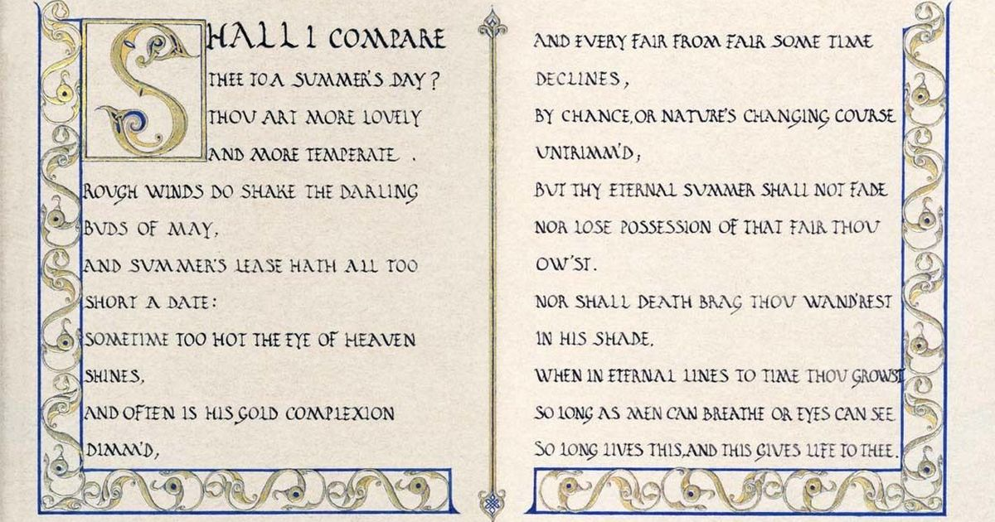

Slide 47
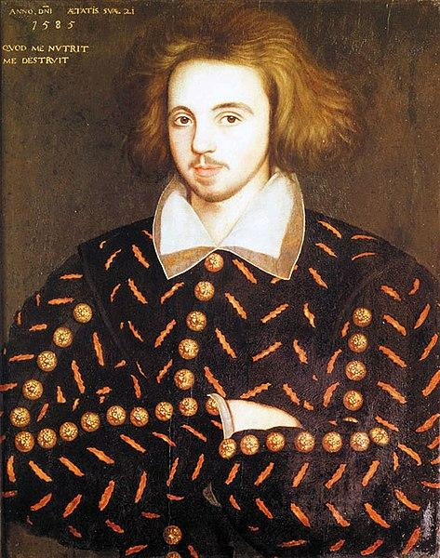
CHRISTOPHER MARLOWE
Born: 6 February 1564, Canterbury, United Kingdom
Died: 30 May 1593, Deptford, United Kingdom
Books: Hero and Leander, The Passionate Shepherd to
His Love, etc
Nicknames: Kit, Mercury, Marcarde, The Muses'Darling

Slide 48
ABOUT
Christopher Marlowe Born in Canterbury, educated at Cambridge.
Most suggestive figures of English Renaissance and the greatest of Shakespeare's predecessors.
Became connected with a company of actors for whom he wrote plays.
He has written poetry and translated some of the poems of Lucan and Ovid.
Famous works as the first great English playwright is Dr. Faustus, Tamburlaine and The Jew of Malta.
His poems are filled with exuberance (Carpe Diem- Live for the day or Seize the moment) which marks him clearly as a man of the Renaissance.
Apparently he liked the philosophy; he was killed in a bar brawl when he was 29.

Slide 49
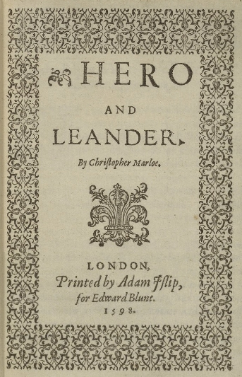
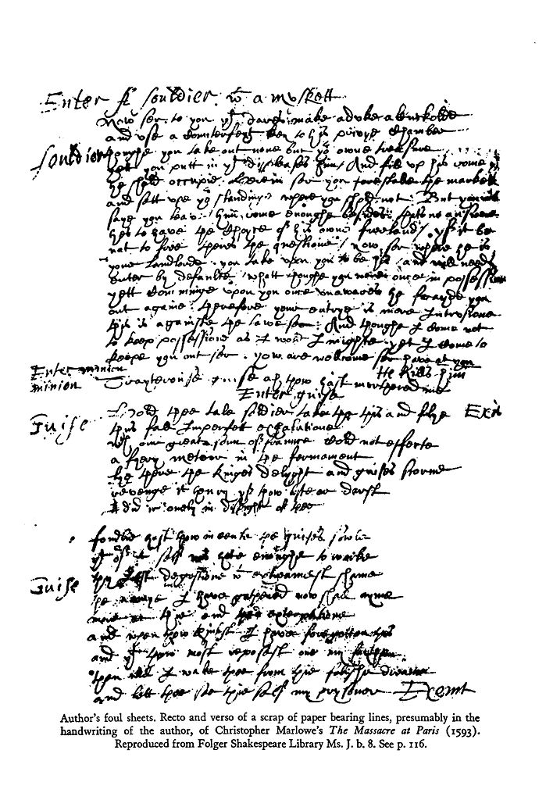

Slide 50
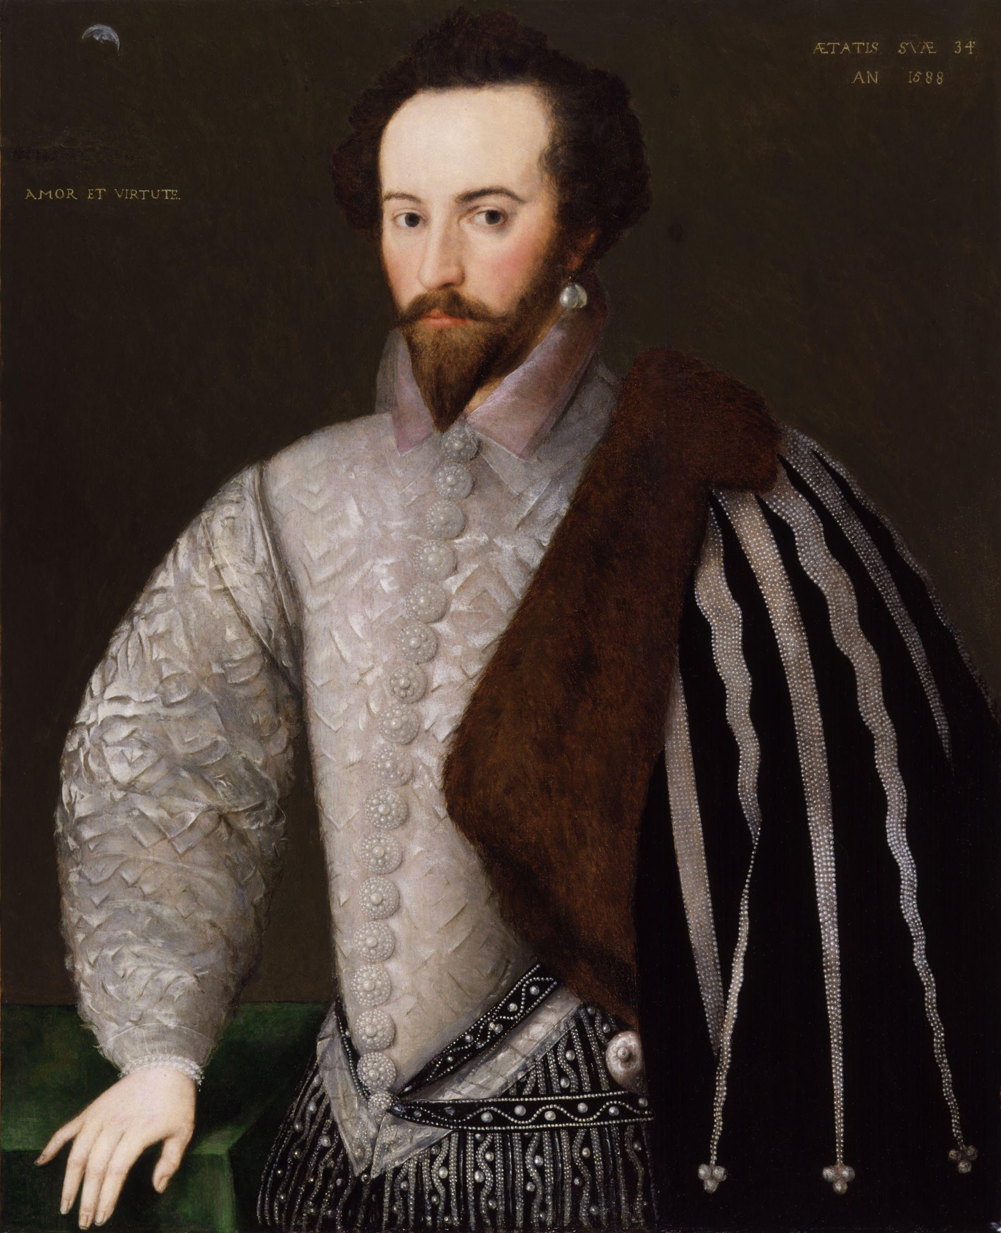
WALTER RALEIGH
Born
c. 1552 (or 1554)
Hayes Barton, East Budleigh, Devon, England
Died
29 October 1618 (aged c. 65)
London, England
Occupation
Writer, poet, soldier, courtier, explorer

Slide 51
Works;
The Nymph’s Reply To The Shepherd
The Lie
What is our life
The silent lover
The excuse
The silent lover etc...
Quotes
But true love is a durable fire, In the mind ever burning, Never sick, never old, never dead, From itself never turning.

Slide 52
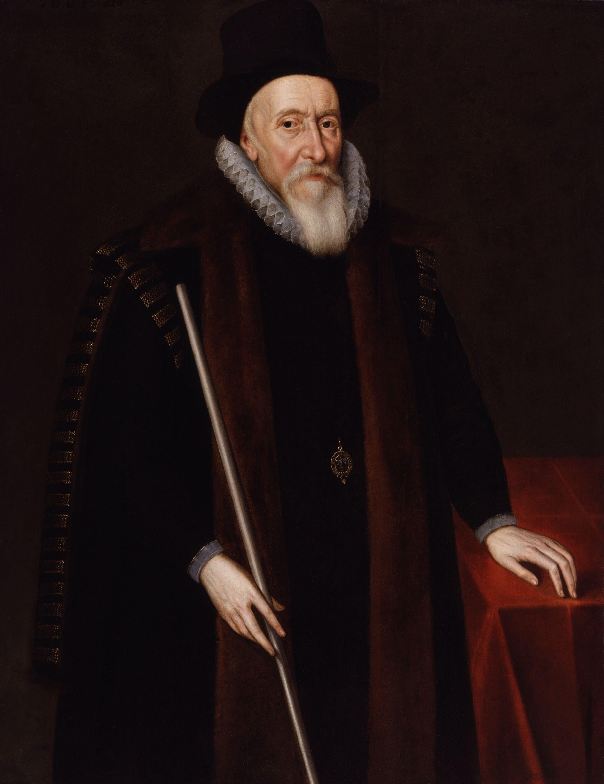
Thomas Sackville
Born
1536 Buckhurst, Sussex
Kingdom of England
Died
19 April 1608 (aged 71–72)
Westminster, London
1st Earl Of Dorset
Works- The Induction,Buckingham'scomplaint

Slide 53
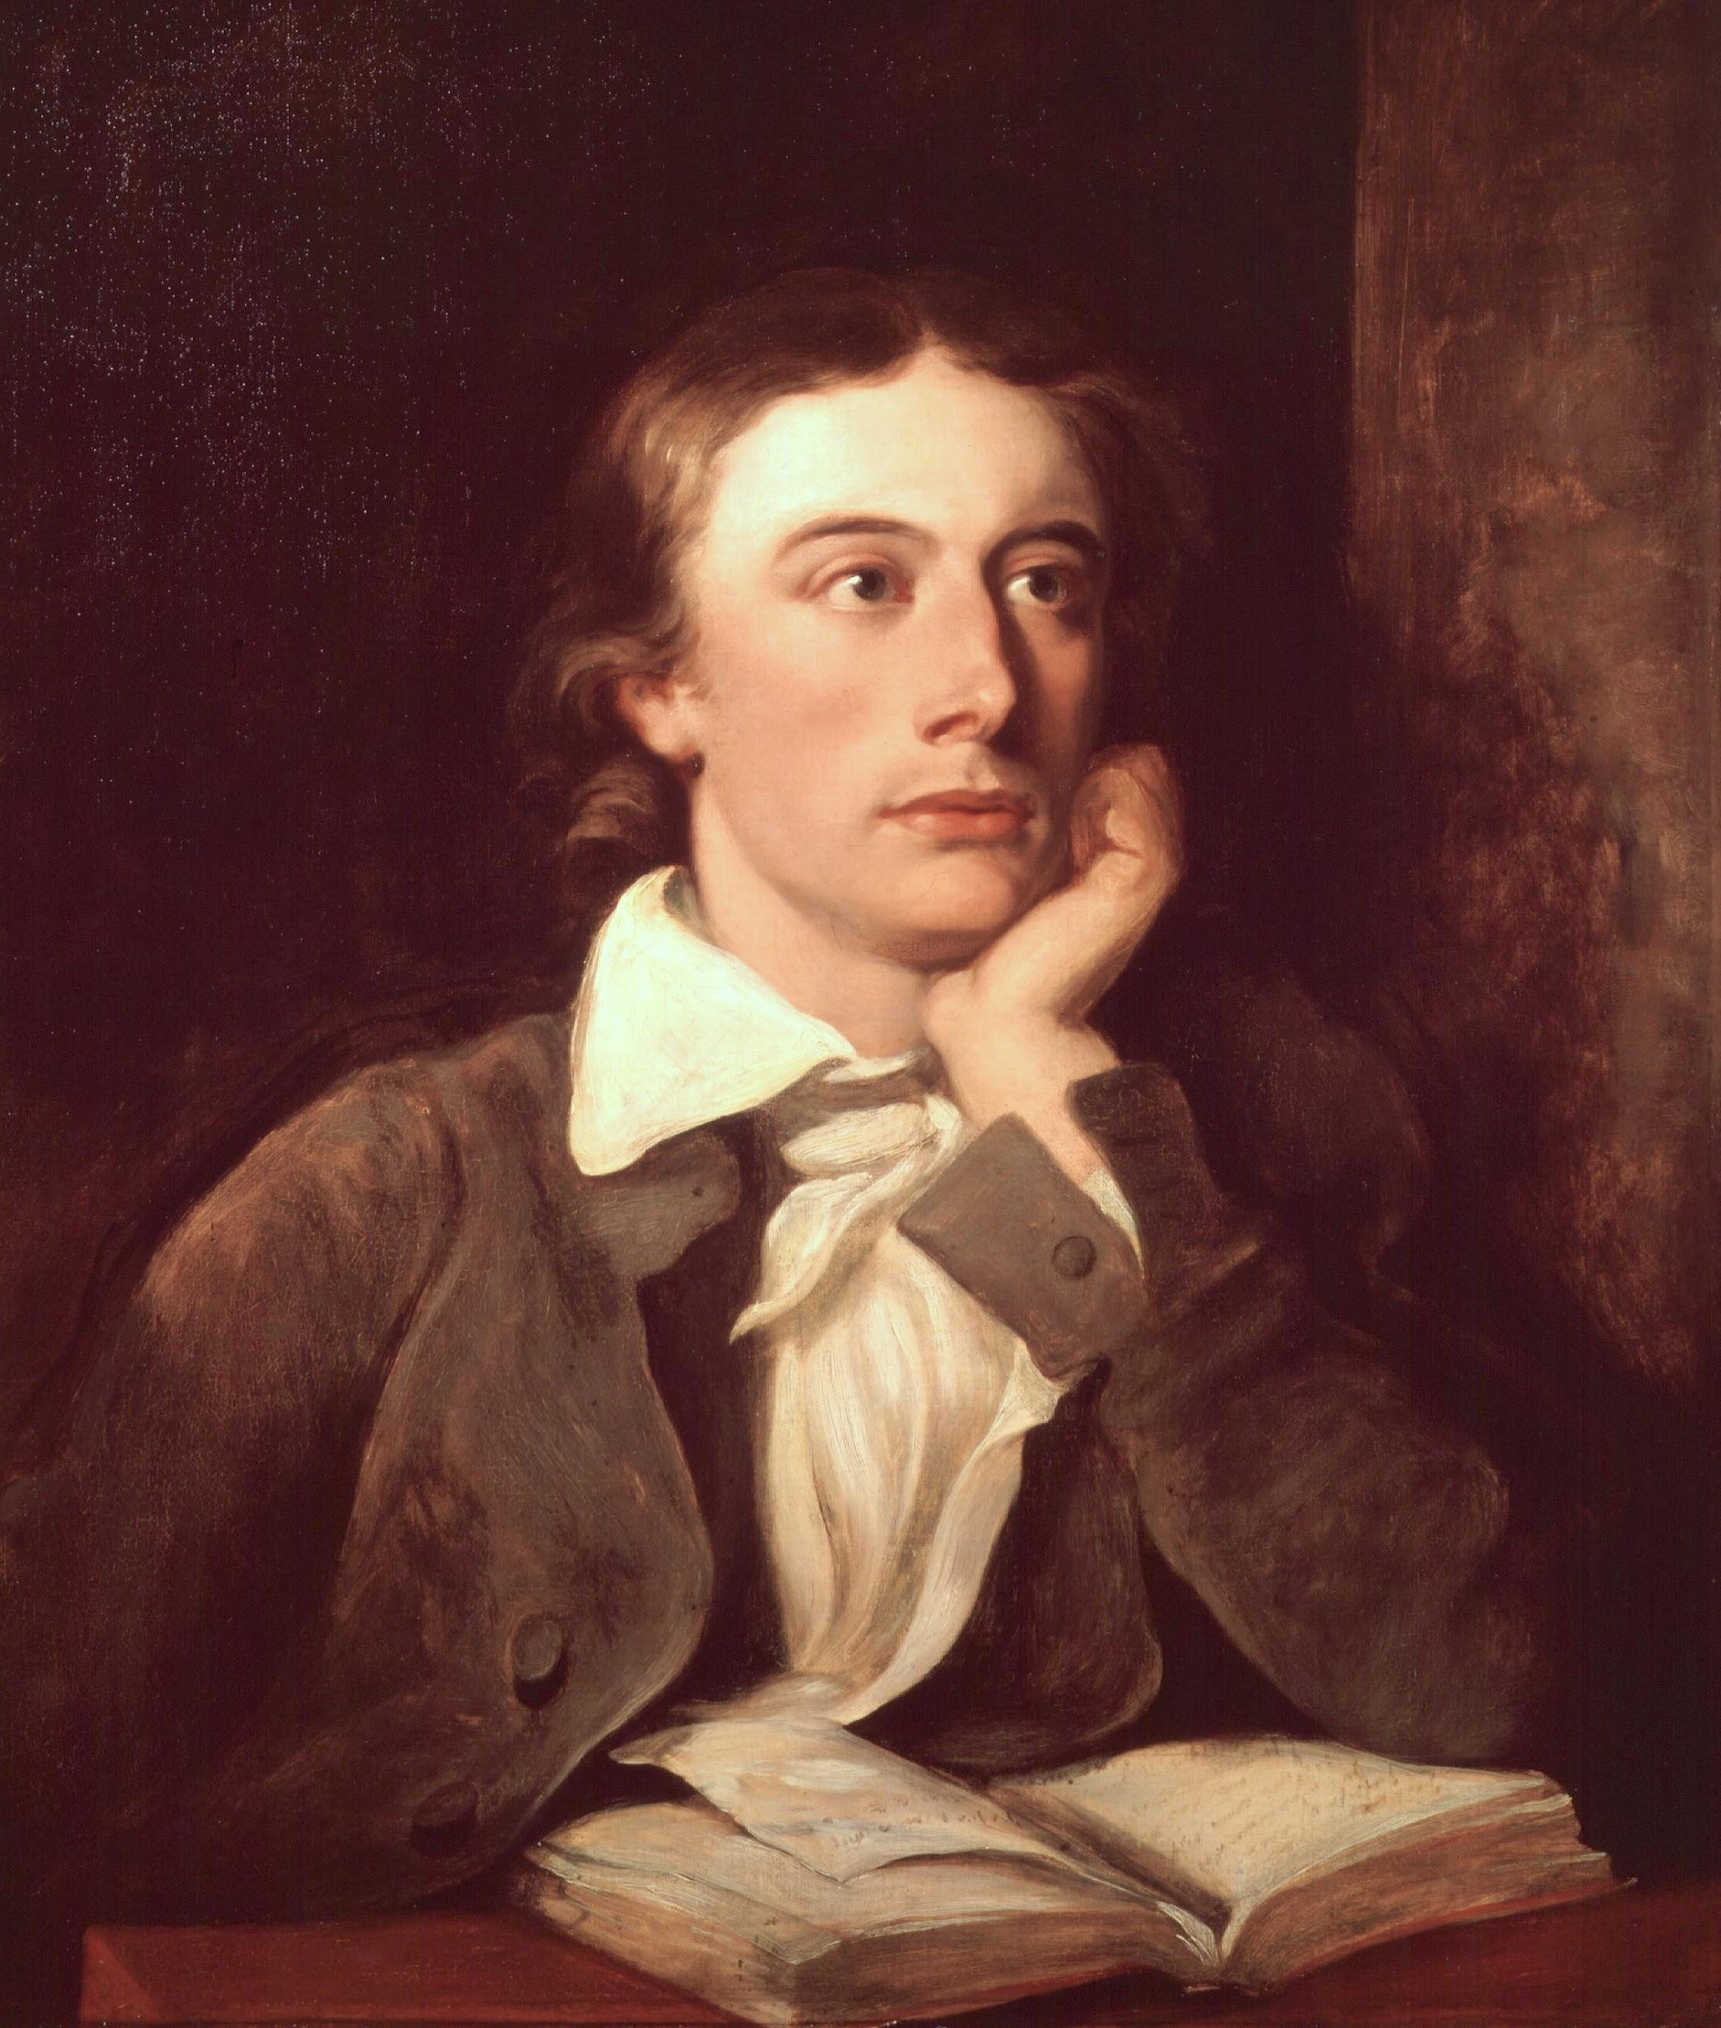
THOMAS CAMPION
He was an English composer, poet and a physician.
Wrote once a hundred lute songs, masques for dancing etc.
Born in London, studied at Cambridge.
His theories on poetry were demolished by Samuel Daniel in “Defence of rhyme”.
Issued a volume of songs of Mourning, wrote a book A New Way of Making
Fewer Parts in Counterpoint by a most familiar and Infallible Rule.

Slide 54
One last poem written by the queen herserlf...
Elizabeth I-Written on a Wall at Woodstock
Oh fortune, thy wresting wavering state
Hath fraught with cares my troubled wit,
Whose witness this present prison late
Could bear, where once was joy's loan quit.
Thou causedst the guilty to be loosed
From bands where innocents were inclosed,
And caused the guiltless to be reserved,
And freed those that death had well deserved.
But all herein can be nothing wrought,
So God send to my foes all they have thought.

Slide 55
THANK YOU

